Slide 1

DAGuest
DataArtEnjoyIT!
! - часть пароля для вифи

Slide 2

Lecture #1
0
Intro & Hello World

Slide 3





Slide 4




Android Academy SPB
Artur Vasilov
Android Developer @ Yandex
Andrei Dmitriev
Founder @
Jug.ru
Konstantin Tskhovrebov
Android Developer @ RedMadRobot
Konstantin Kulikov
Android Developer @
MobileUp

Slide 5




Android Academy SPB
Assel Romanova
Android Developer @ ITMO
Mike Gorunov
Android Developer @ Yandex
Vitaly Markus
Android Developer @
Revolut
Roman Chernyak
Android Developer @
15 Seconds of Fame

Slide 6
Why are we doing that?
Make the world a better place :)
Lack of good developers
Opportunity
Build strong community
What we are asking in return? - commitment

Slide 7
Course
Android Fundamentals
Prerequisite: OOP (Java, C#, Python Objective C), XML
10 meetings
Exercises
Hackathon

Slide 8

28.03 Thursday
3.04 Wednesday
11.04 Thursday
18.04 Thursday
24.04 Wednesday
16.05 Thursday
24.05 Friday
6.06 Thursday
13.06 Thursday

Slide 9
Intro to Android
Views in Android
Lists & Adapters (recycling views)
Threads and concurrency
Networking
Persistence
Fragments
Working from the background
Architecture
Extra: Firebase

Slide 10


Slide 11
developer.android.com

Slide 12

stackoverflow.com

Slide 13


Online Lessons
Developing Android Apps goo.gl/u1pxZv
Optional: Nano Degree
Optional: “Android Basics” courses

Slide 14

Nanodegree Android Basics
Android Basics: User Interface
Android Basics: User Input
Android Basics: Multi-screen Apps
Android Basics: Networking
Android Basics: Data Storage

Slide 15
Android Developer Nanodegree
Developing Android Apps
Advanced Android App Development
Gradle for Android and Java
Material Design for Android Developers
Android Wear Development

Slide 16
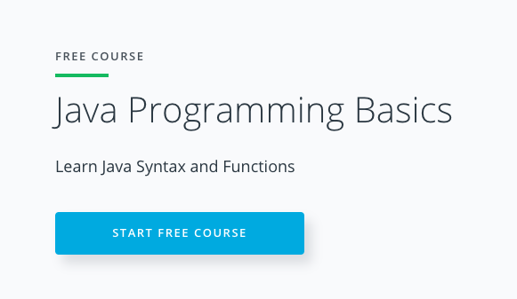
Java for you
goo.gl/XfT2FY

Slide 17
Check list
Join our telegram chat: t.me/androidacademyspb
Prepare questions and code :)

Slide 18

Ask questions.
It’s for you.

Slide 19
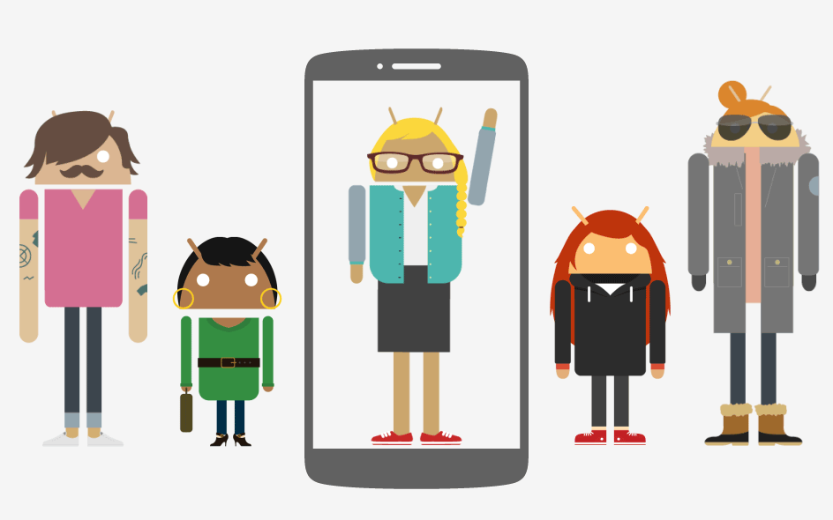

Slide 20
Android development specifics
Sometimes slow internet connection (or offline)
Limited battery
Limited CPU / RAM
Slow apps updates
Fragmentation

Slide 21
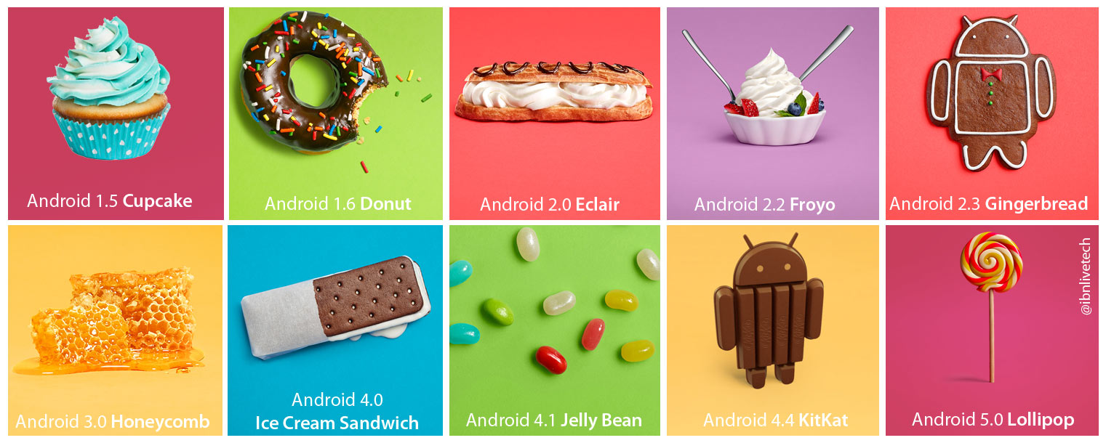

Slide 22


Slide 23


Slide 24


Slide 25


Slide 26


Slide 27
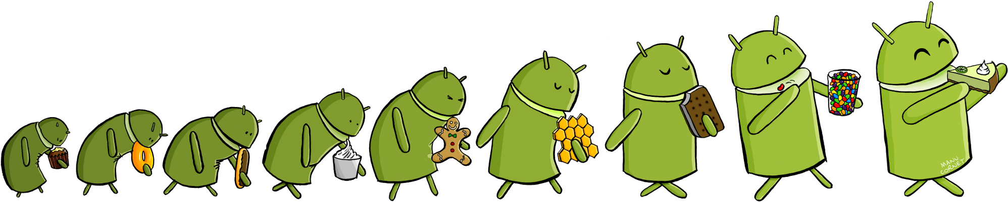
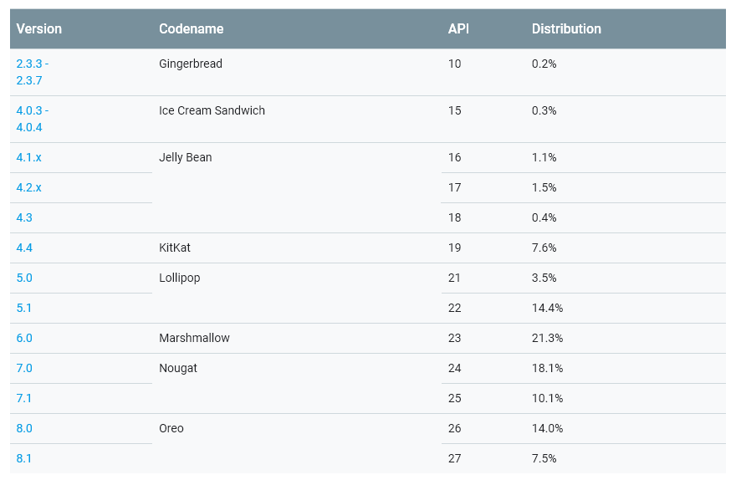
developer.android.com/about/dashboards

Slide 28
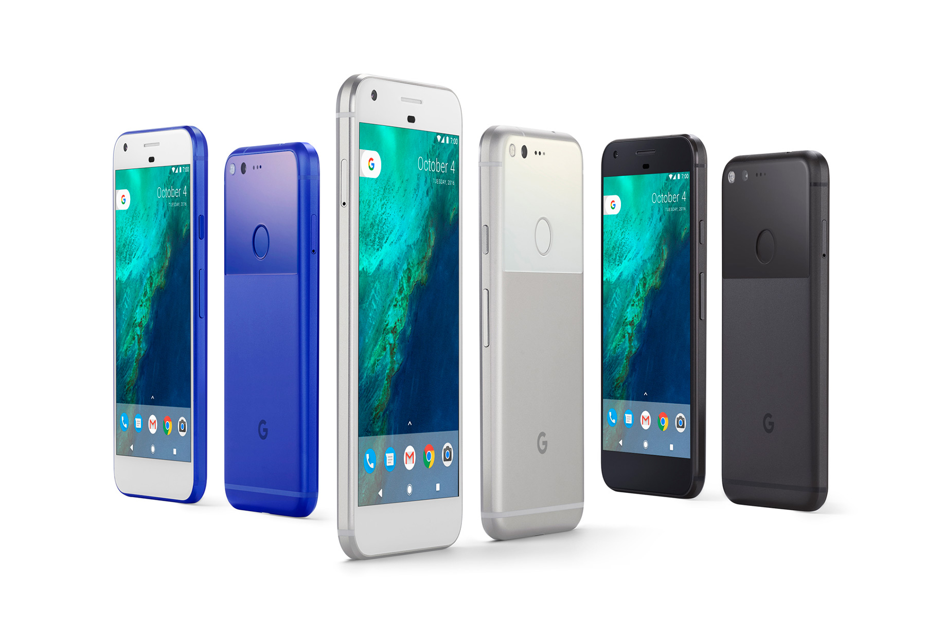
Notes:
named after a robot in Bladerunner

Slide 29
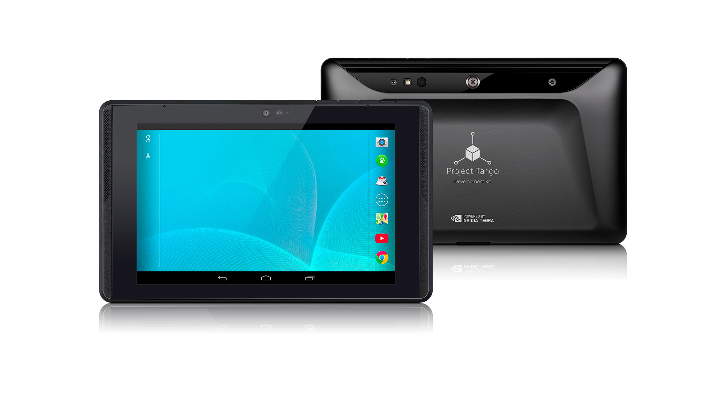

Slide 30
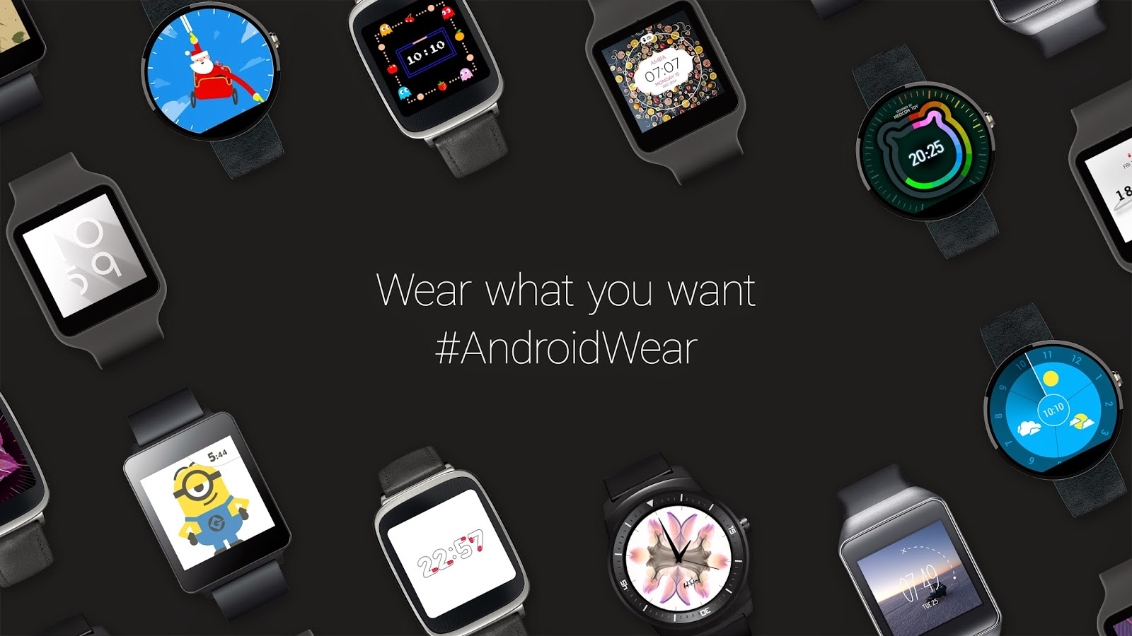
Watches - Android Wear

Slide 31
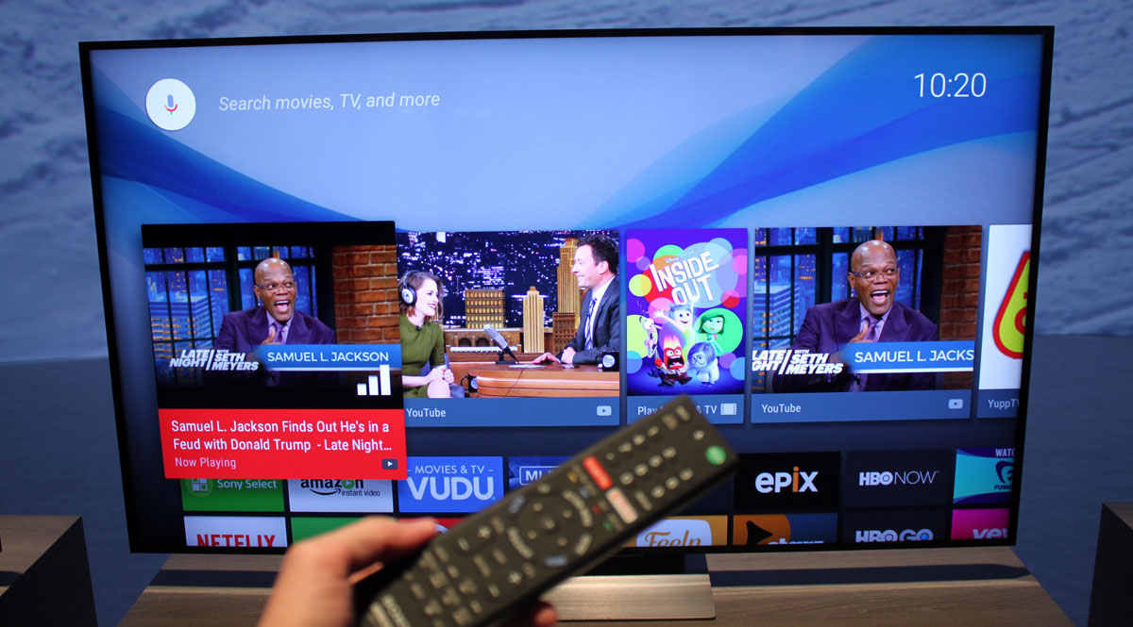
TV

Slide 32


Slide 33
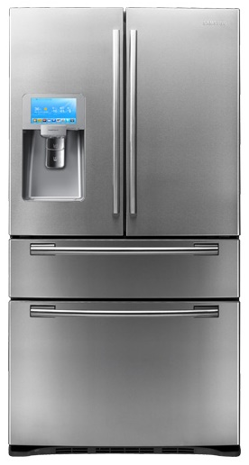

Slide 34
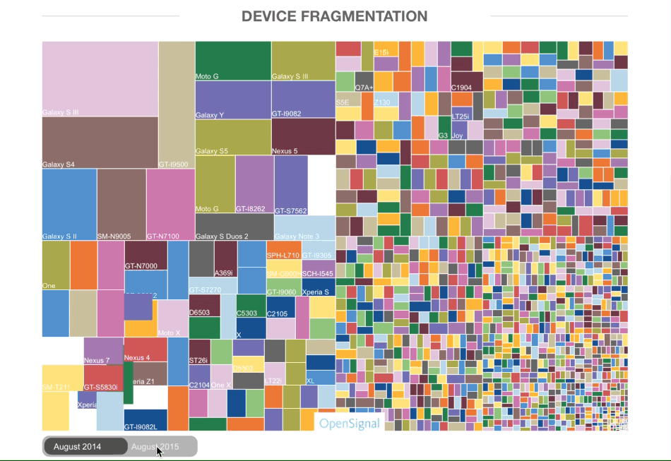

Slide 35






Slide 36


Slide 38
Go on

Slide 39
Agenda
Android Studio & First Project
Activity & Layouts
Resources
Java & xml works together
Different configurations
Intents
Activity Lifecycle
Toasts, Logs, etc.

Slide 40
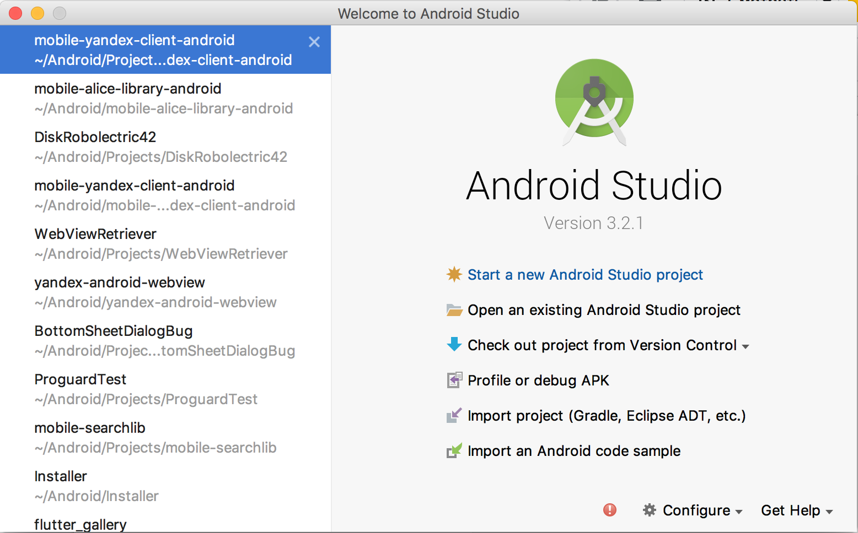
File >> New Project

Slide 41
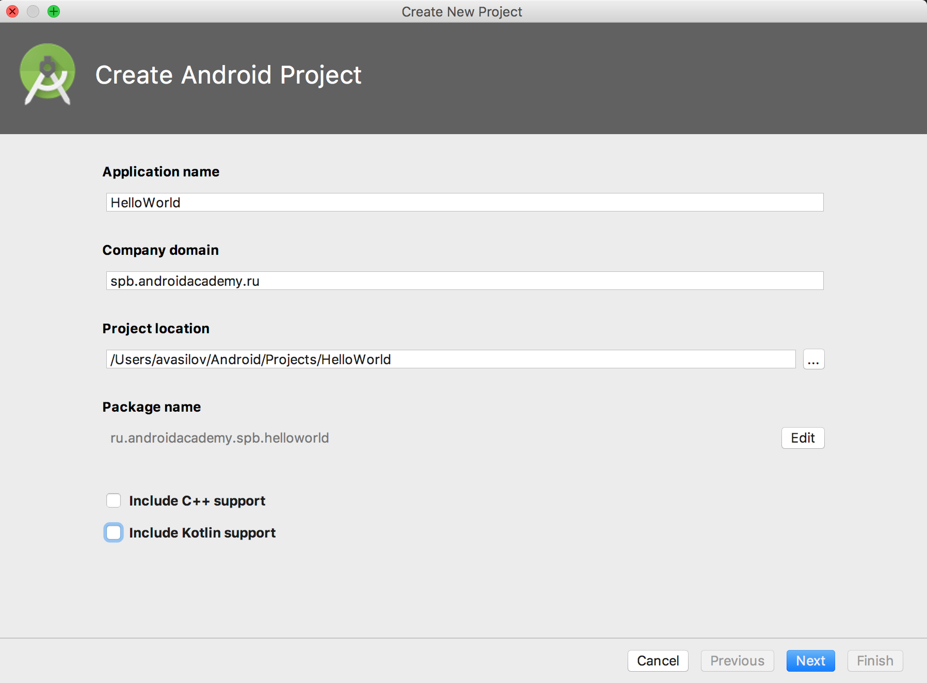
File >> New Project

Slide 42
File >> New Project

Slide 43
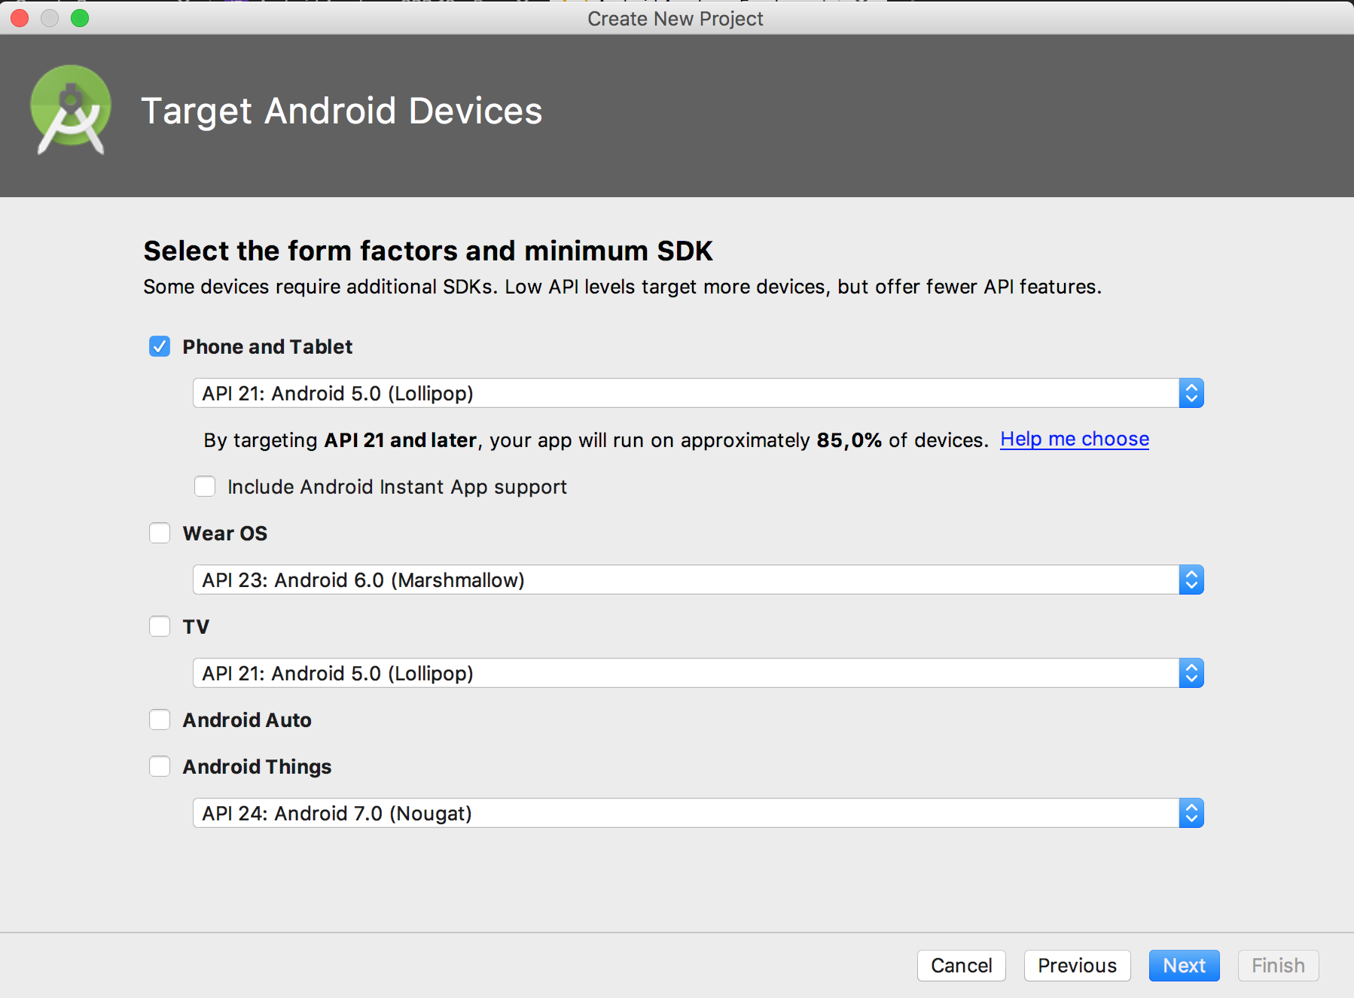

Slide 44
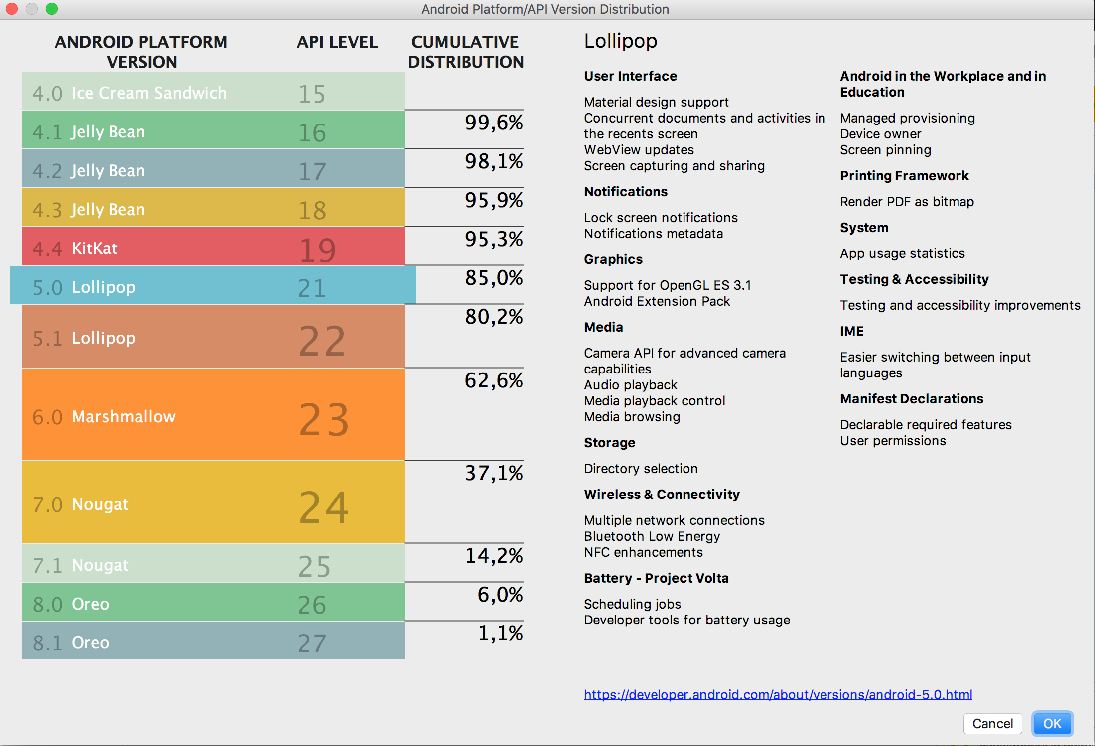
developer.android.com/about/dashboards/index.html

Slide 45
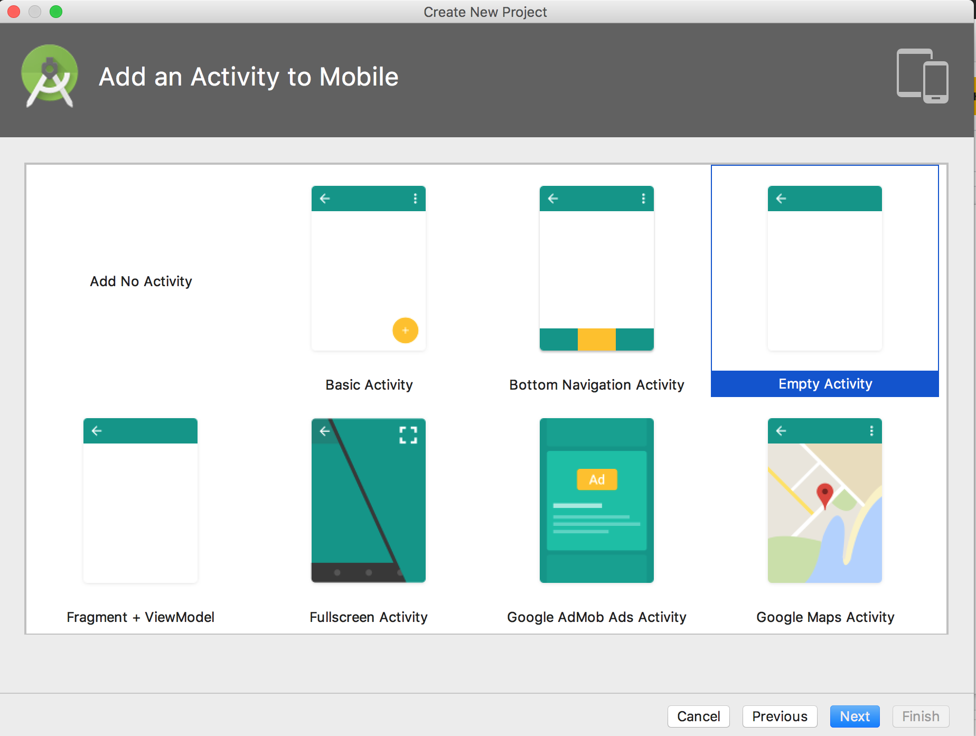

Slide 46
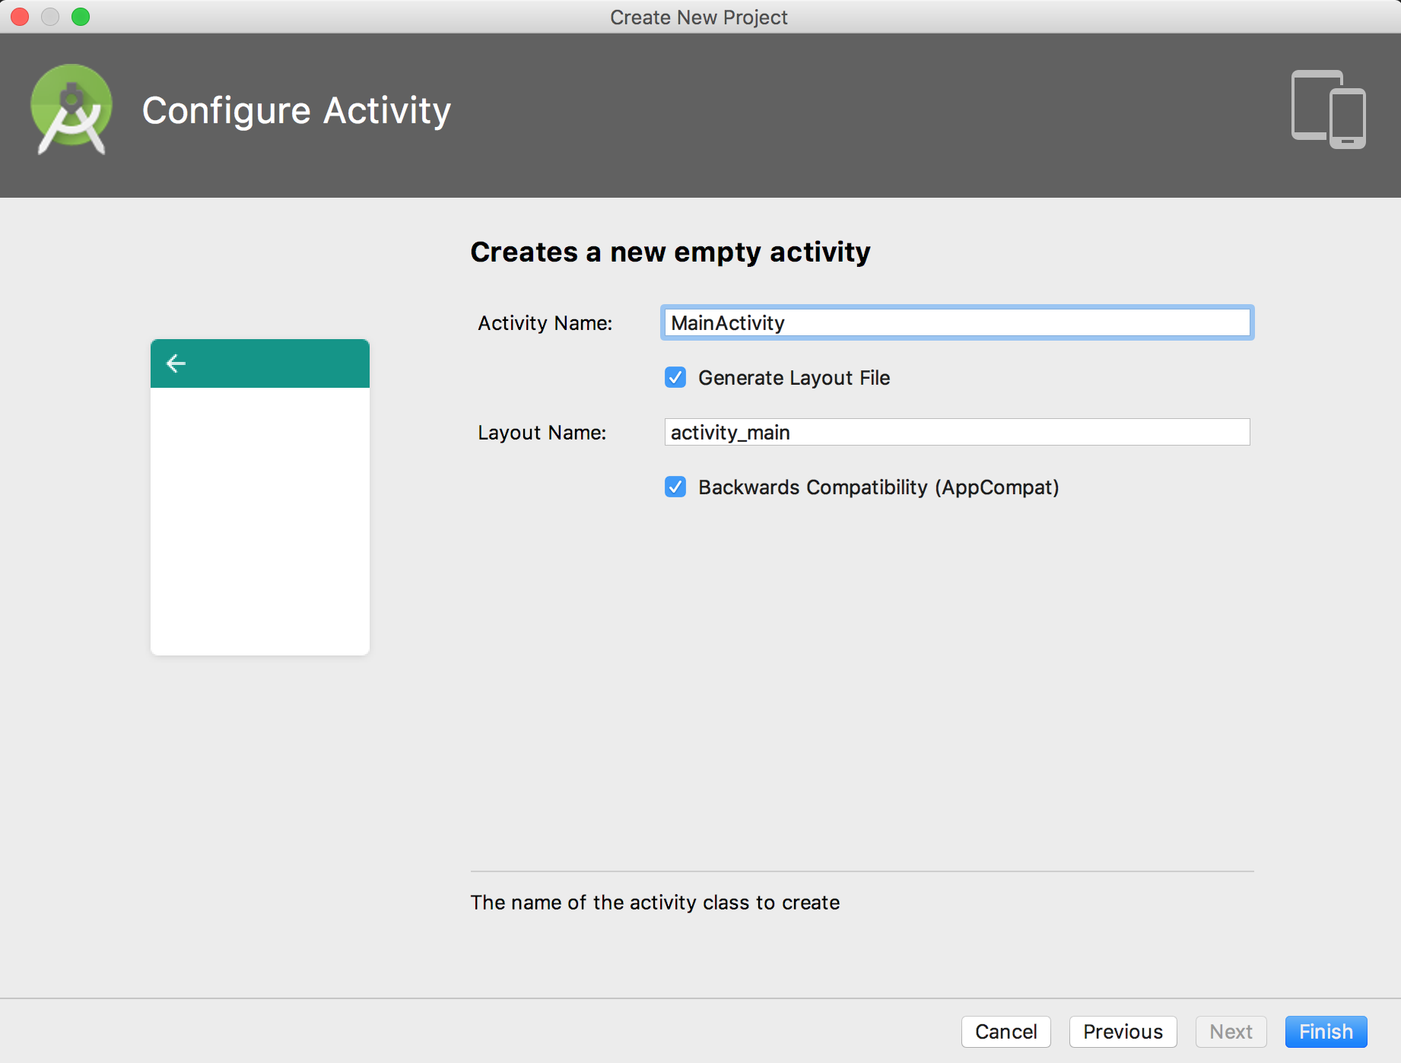

Slide 47
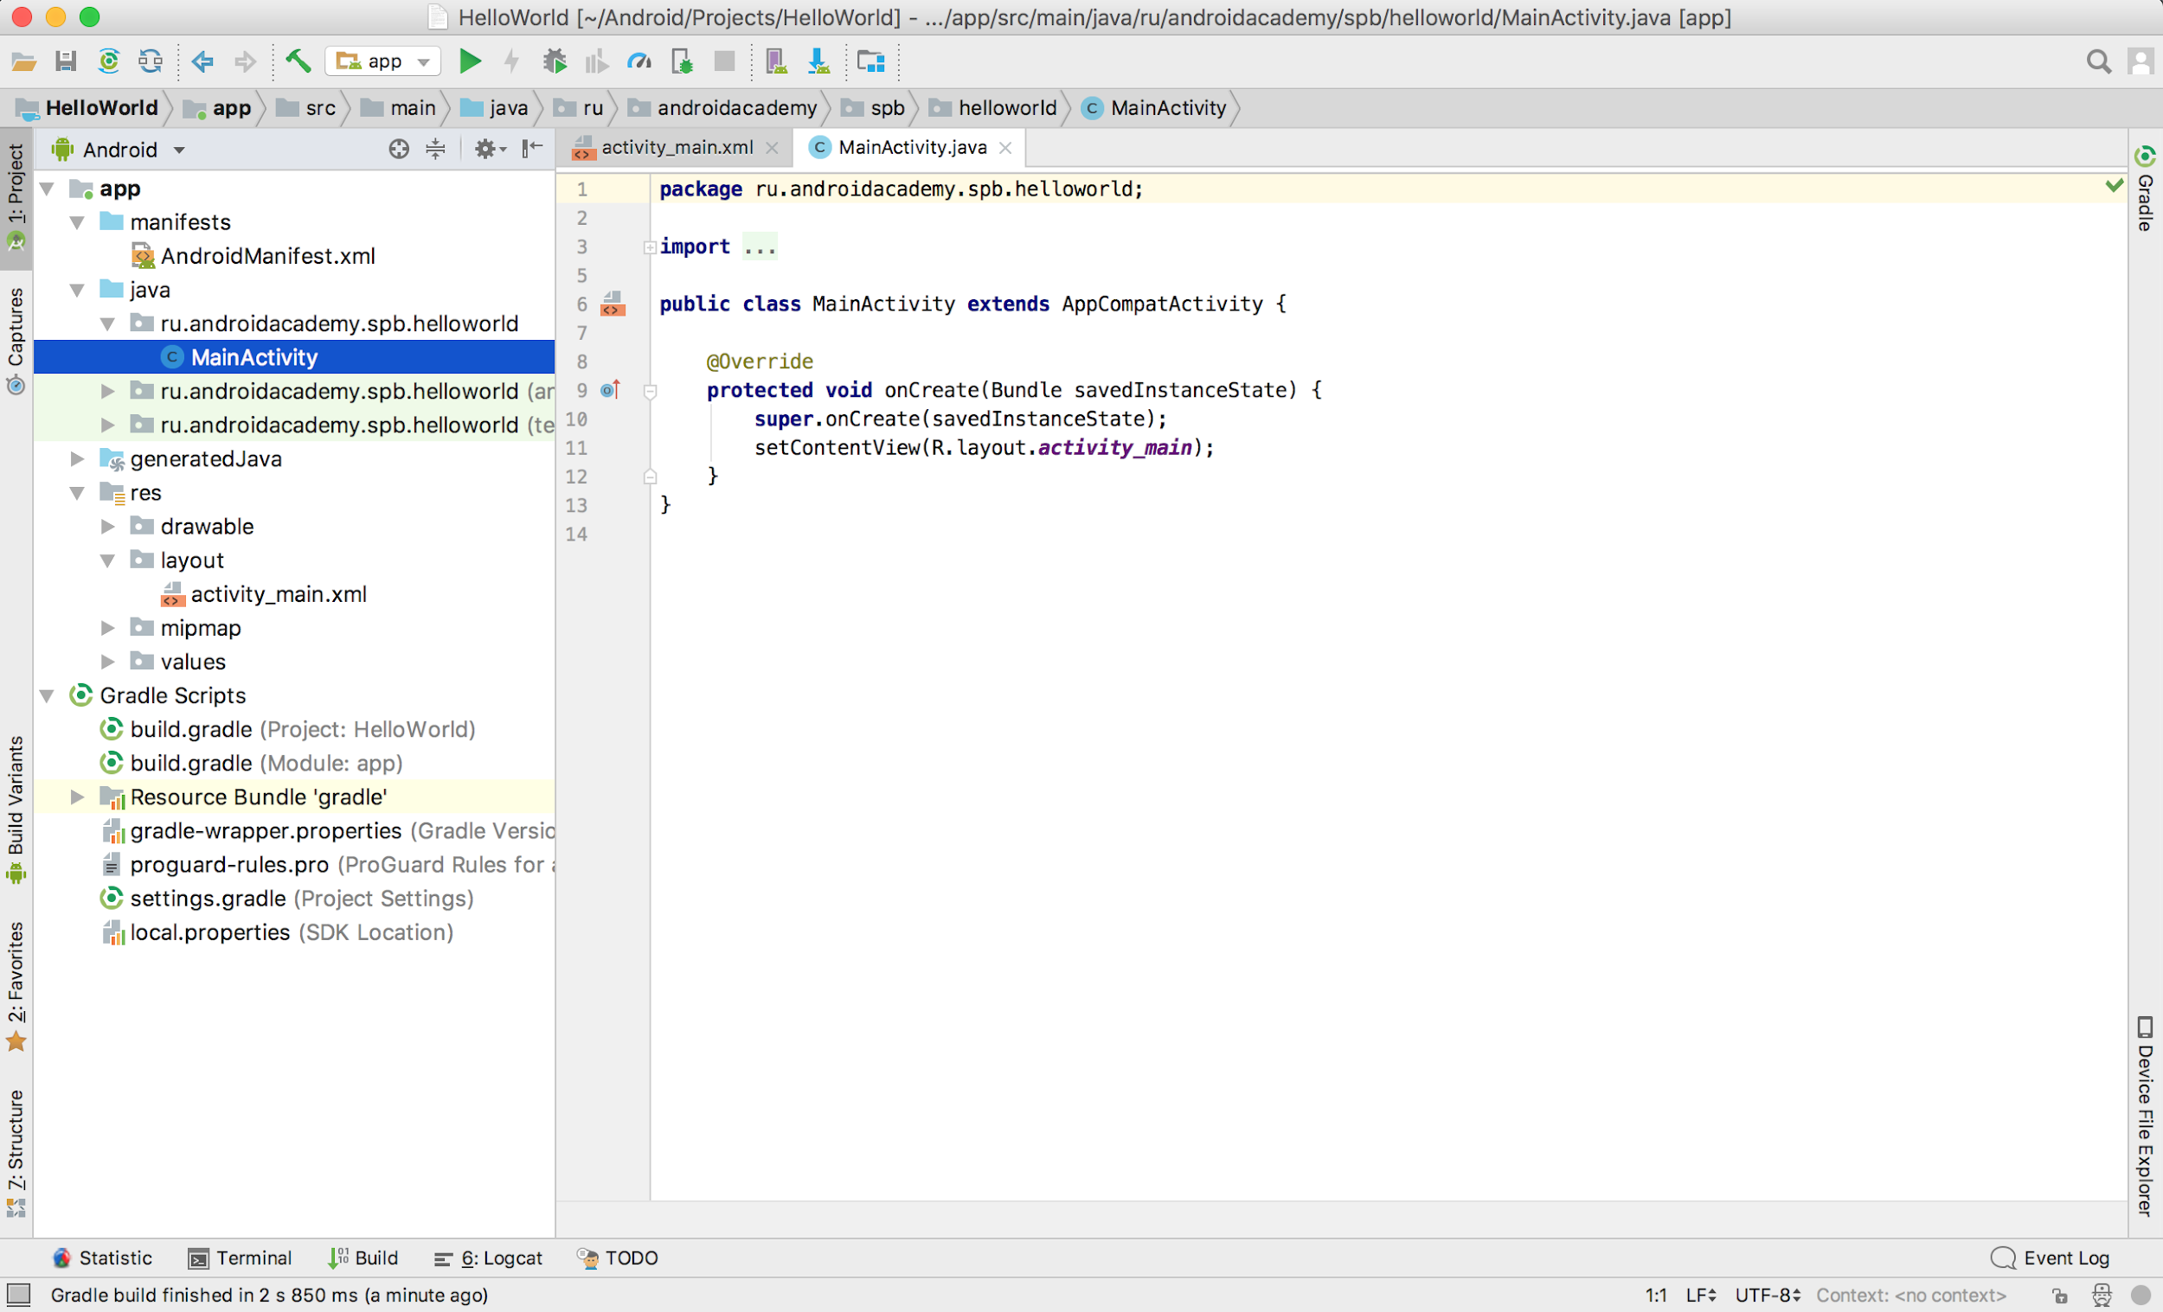

Slide 48
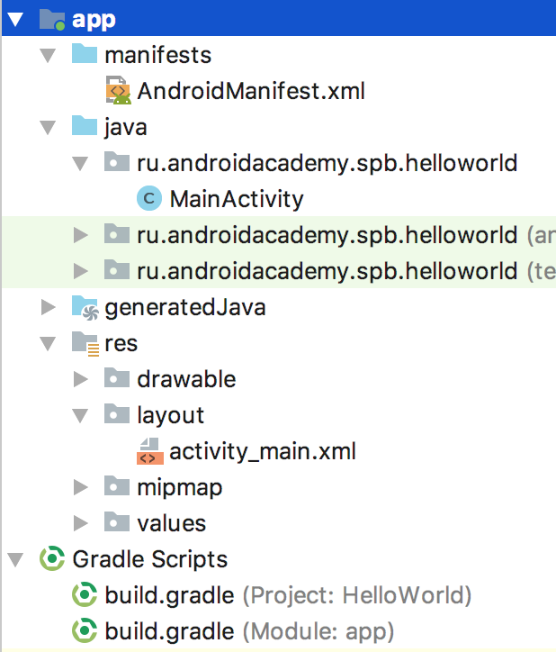
3 Interesting Things:
AndroidManifest.xml
MainActivity (class)
activity_main.xml

Slide 49
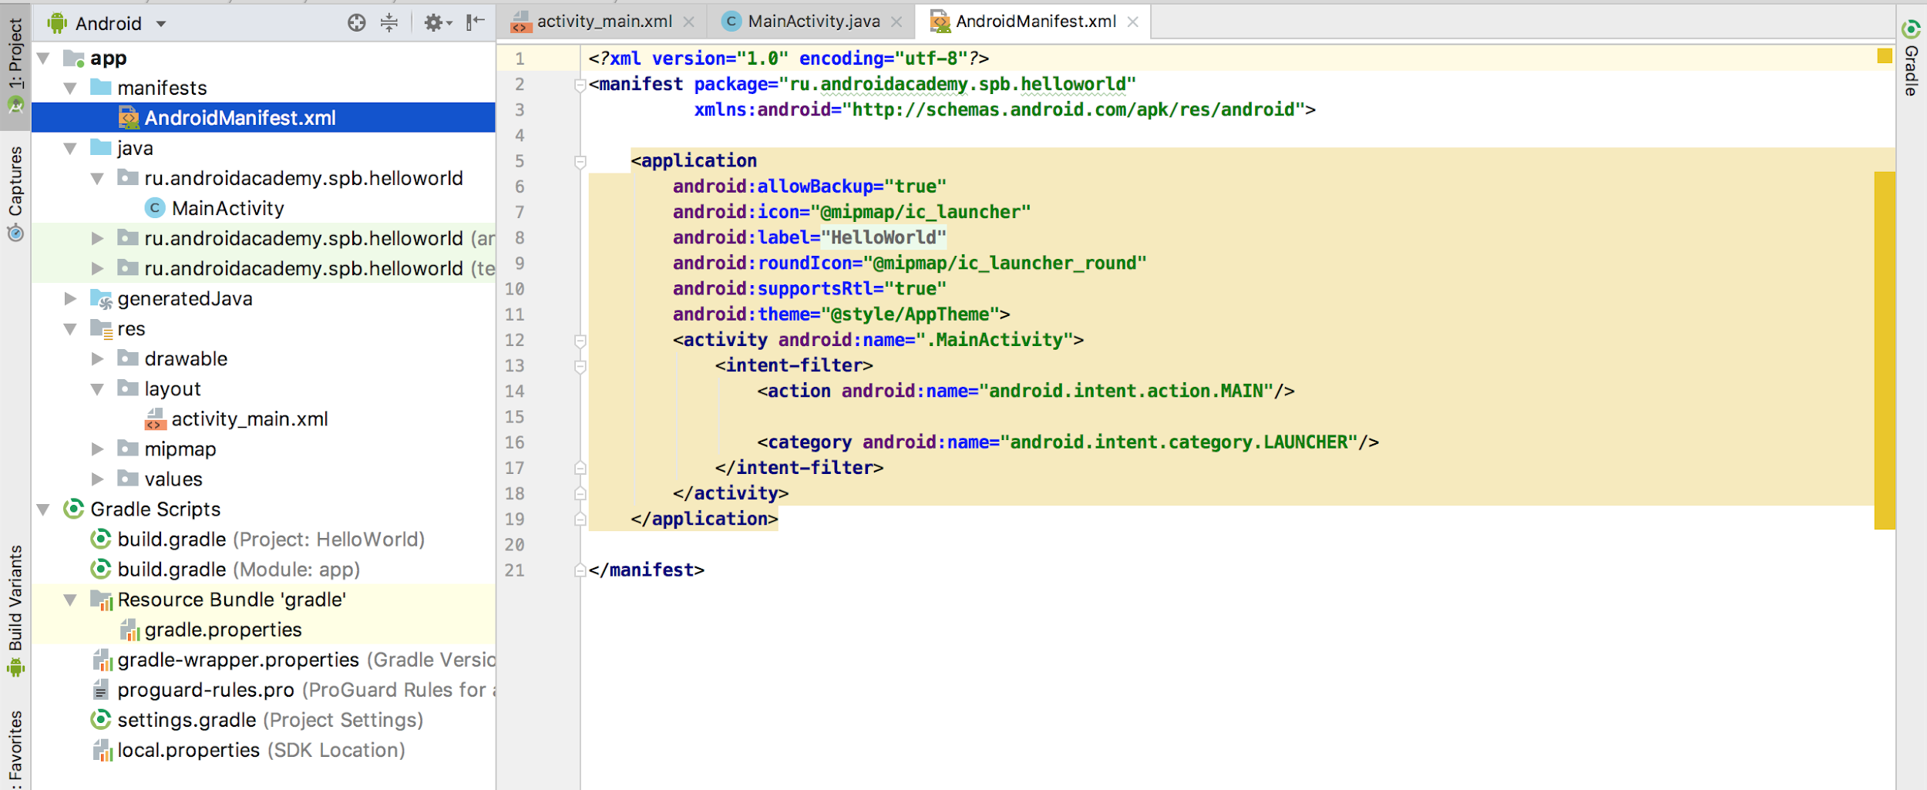

Slide 50
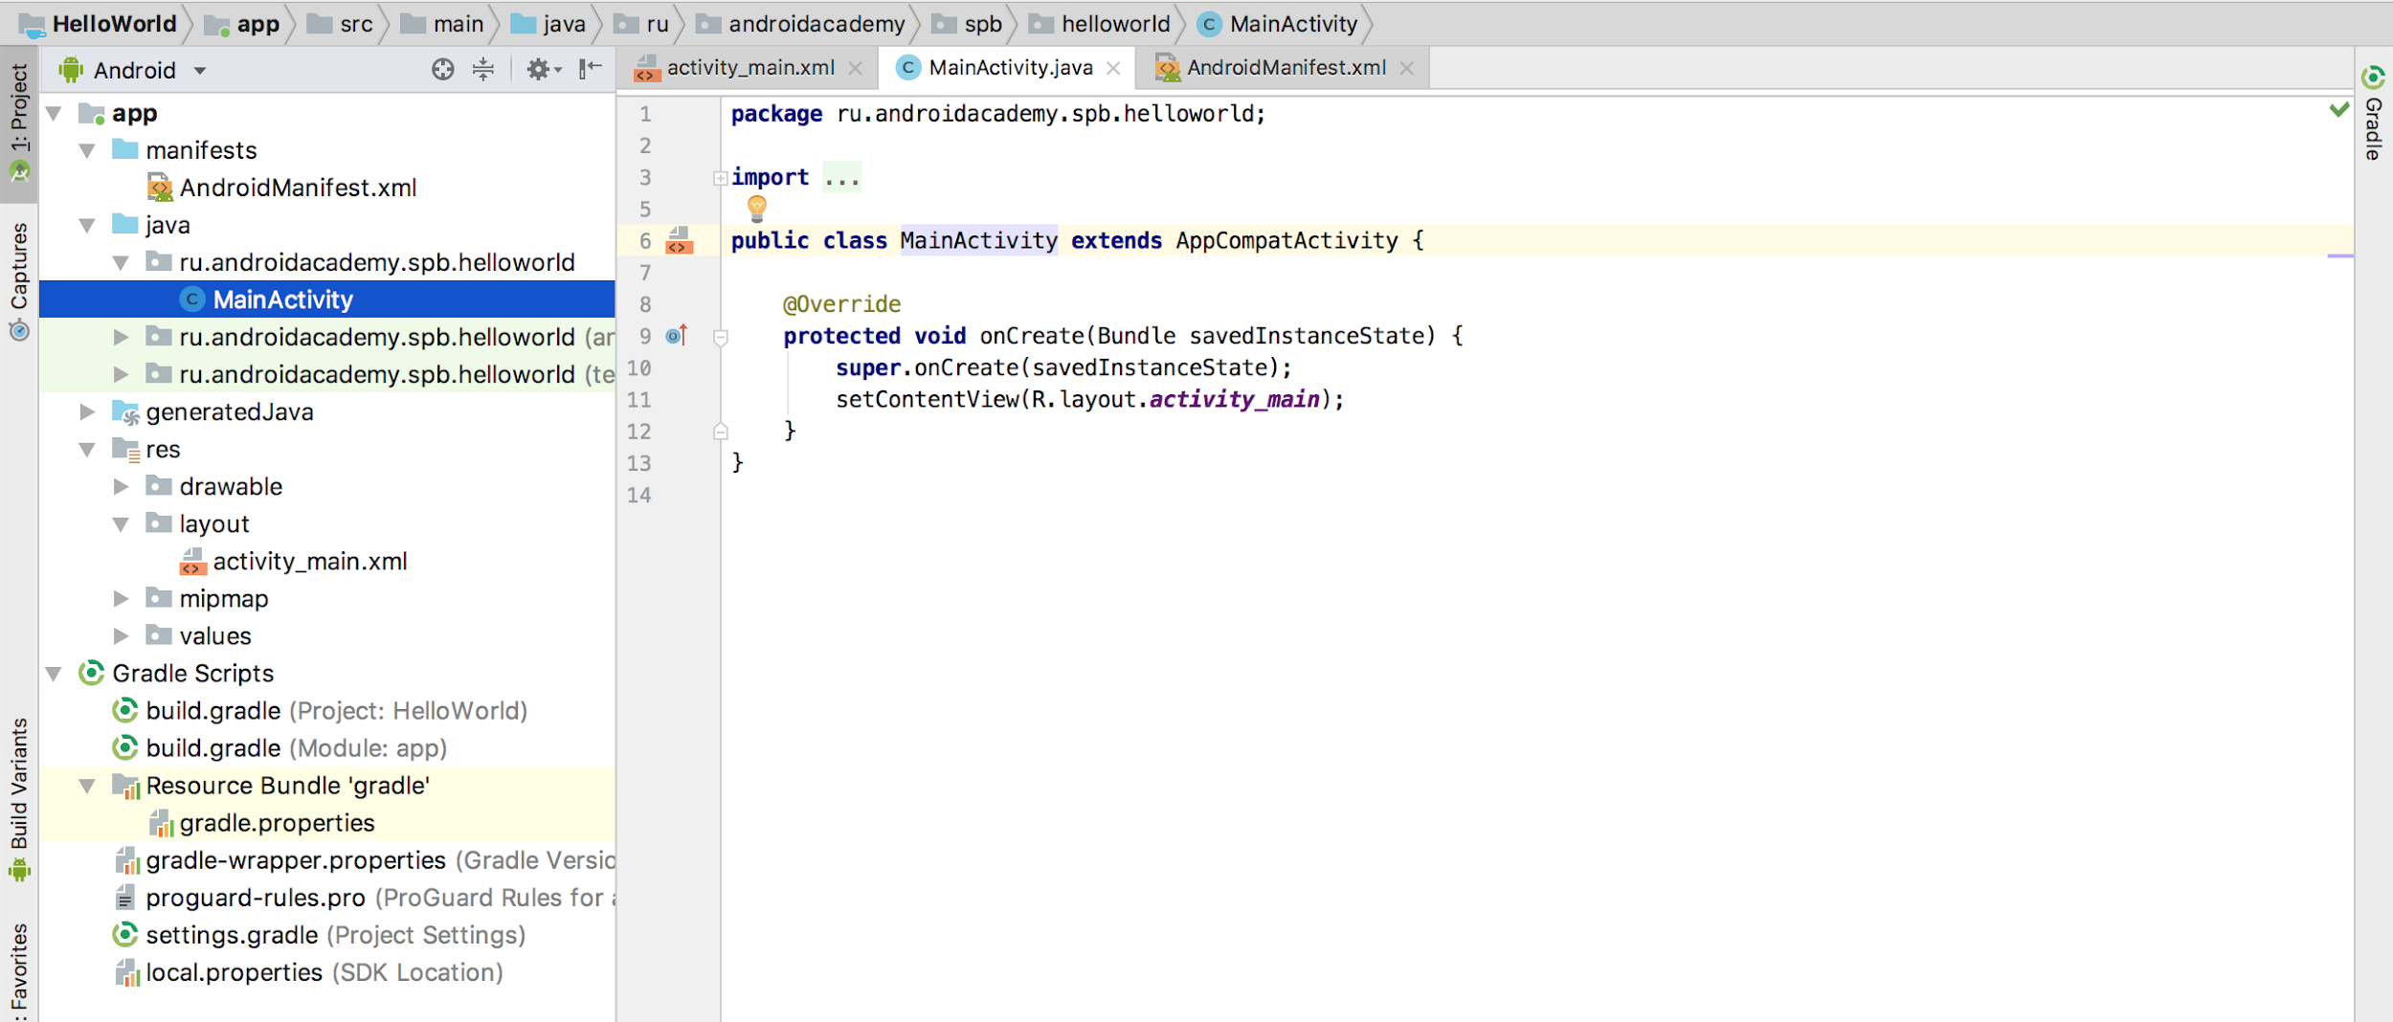

Slide 51
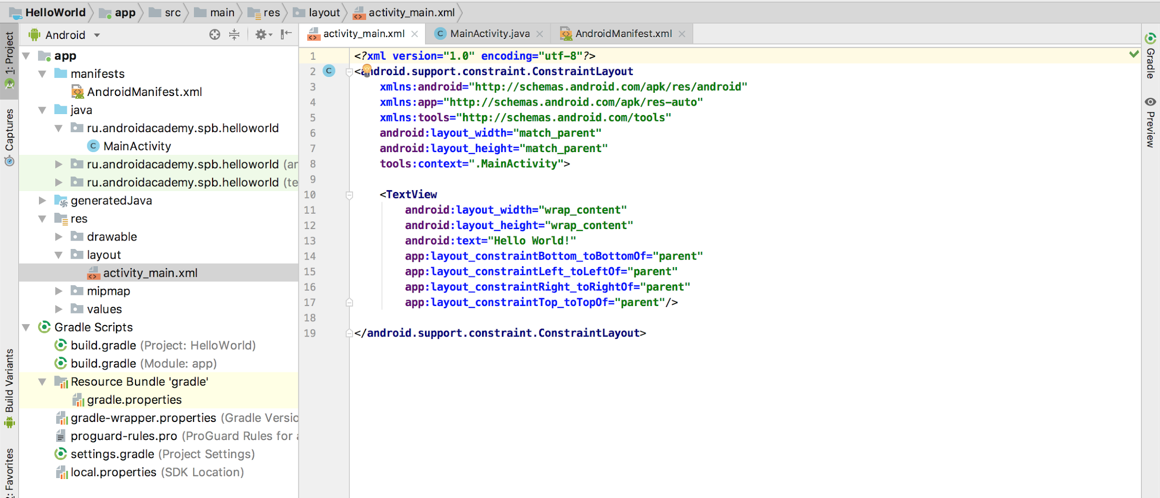

Slide 52
Android Application Structure for now
Application
… Manifest ...
Activity
A
Activity
B
Activity
C
...
developer.android.com/guide/topics/manifest/manifest-intro.html

Slide 53
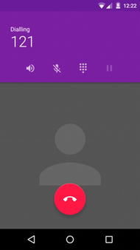
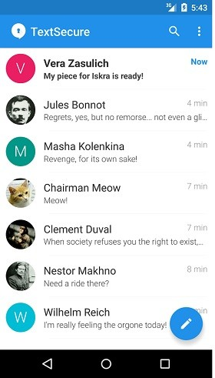
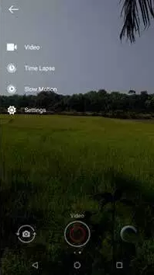
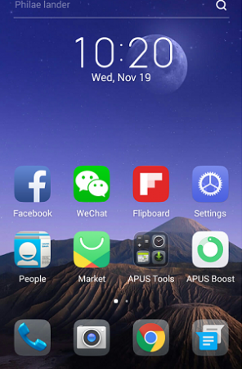
What’s an Activity?
Activity - a component with a screen with which users can interact in order to do something.
developer.android.com/guide/components/activities.html

Slide 54
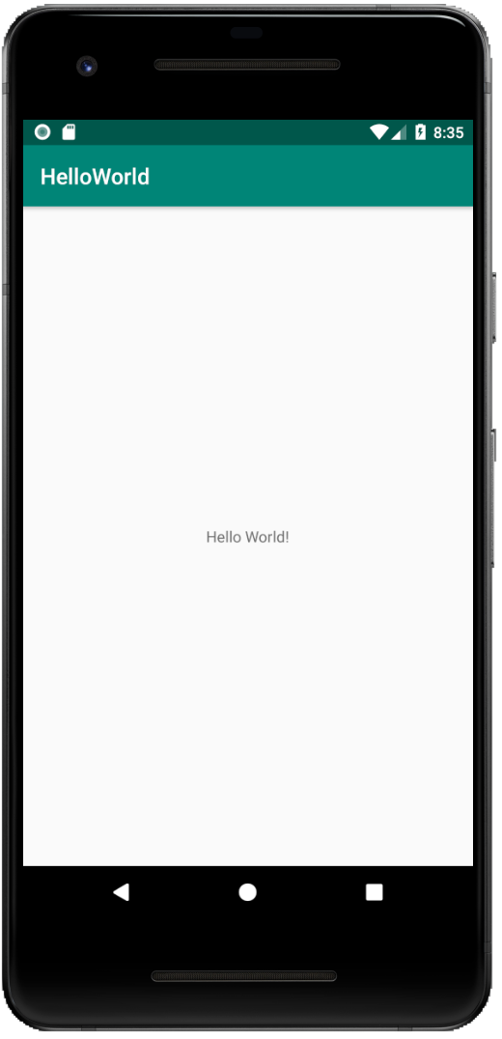
How Does An Activity Look?

Slide 55
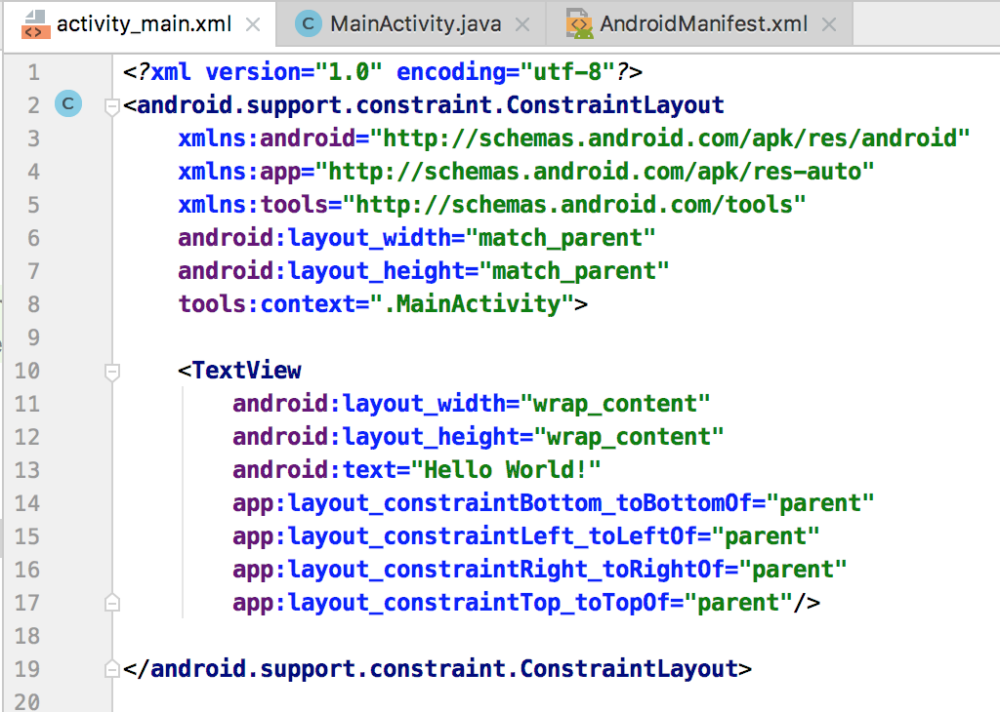
How Does An Activity Look?
But for us it looks like this: (activity_main.xml)

Slide 56
What Does An Activity Do?
Activity
Developer
User

Slide 57
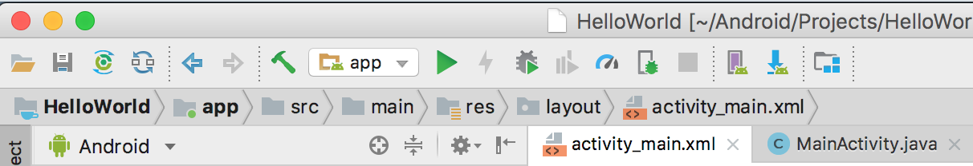
How to run the app?
Simple answer:
developer.android.com/training/basics/firstapp/running-app.html

Slide 58
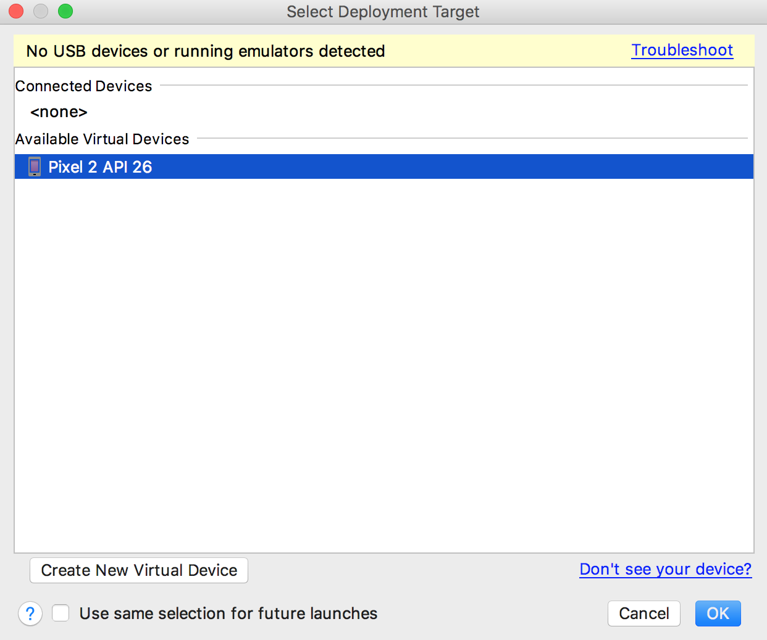
How to run the app?
We need to choose a device.

Slide 59
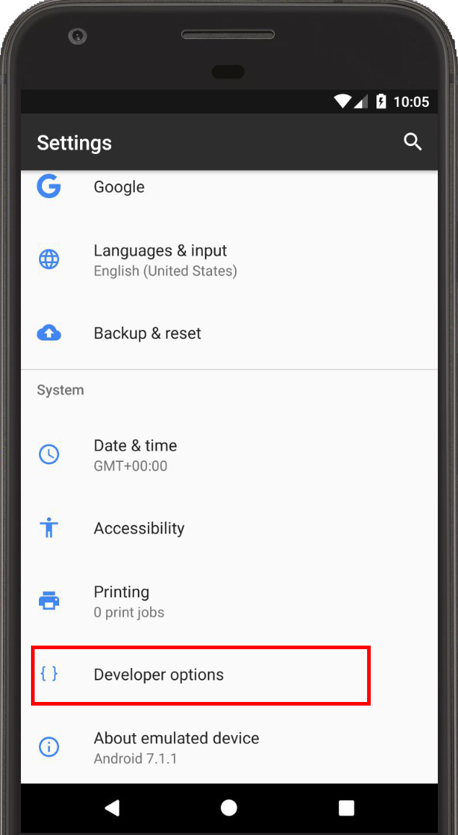
Option 1: A Real Device
Allow USB Debugging.
It’s in the Developer Options settings, which might be hidden
Read more:
developer.android.com/tools/device.html
developer.android.com/studio/debug/dev-options.html

Slide 60
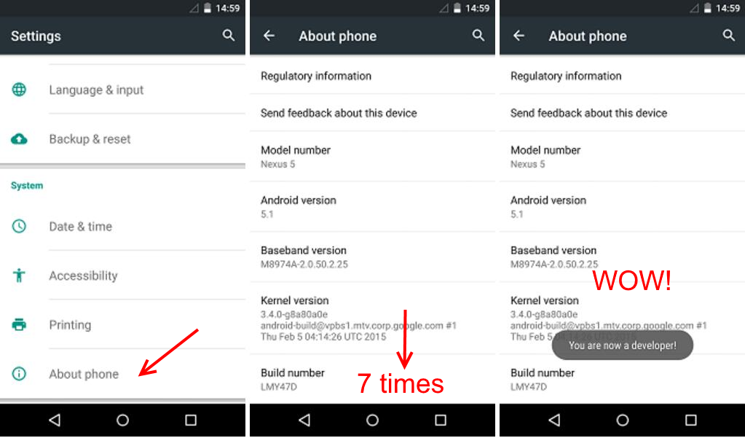
Android developer in 30 seconds

Slide 61
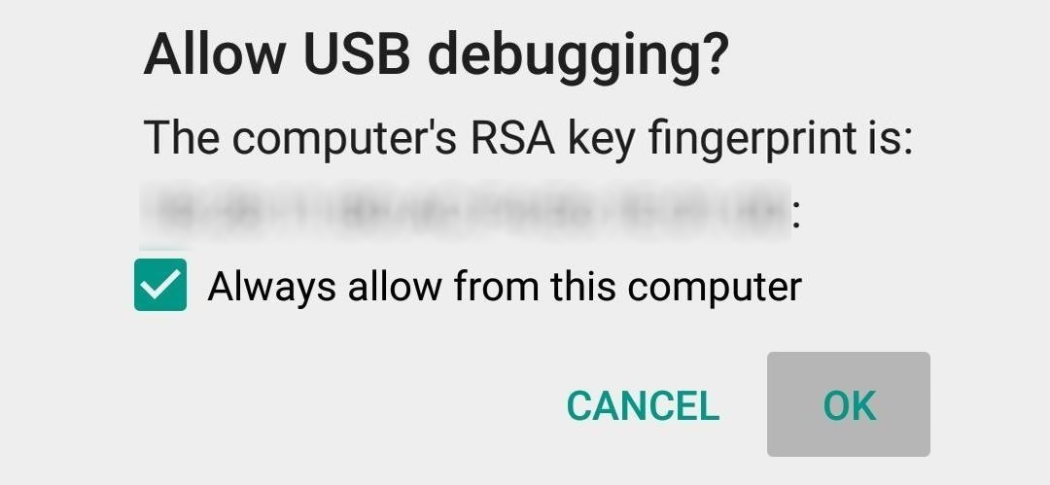
Confirm popup and run

Slide 62
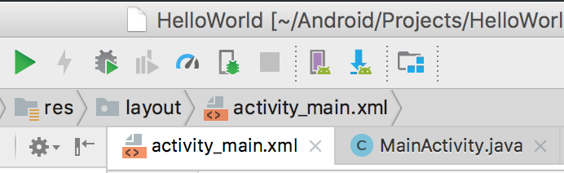
Option 2: A Virtual Device
Open the AVD manager and create a virtual device.
The run dialog will offer you to start it.

Slide 63
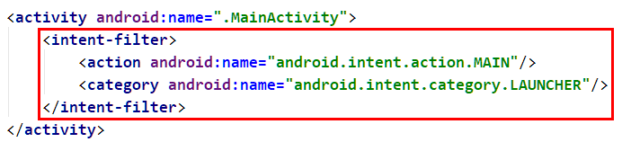
And Then What Happens?
Android Studio launches the app on a device for you.
When an app launches,
Android looks at the application’s manifest,
and decides which activity to show.
Notes:
ADB, Intent Filter

Slide 64
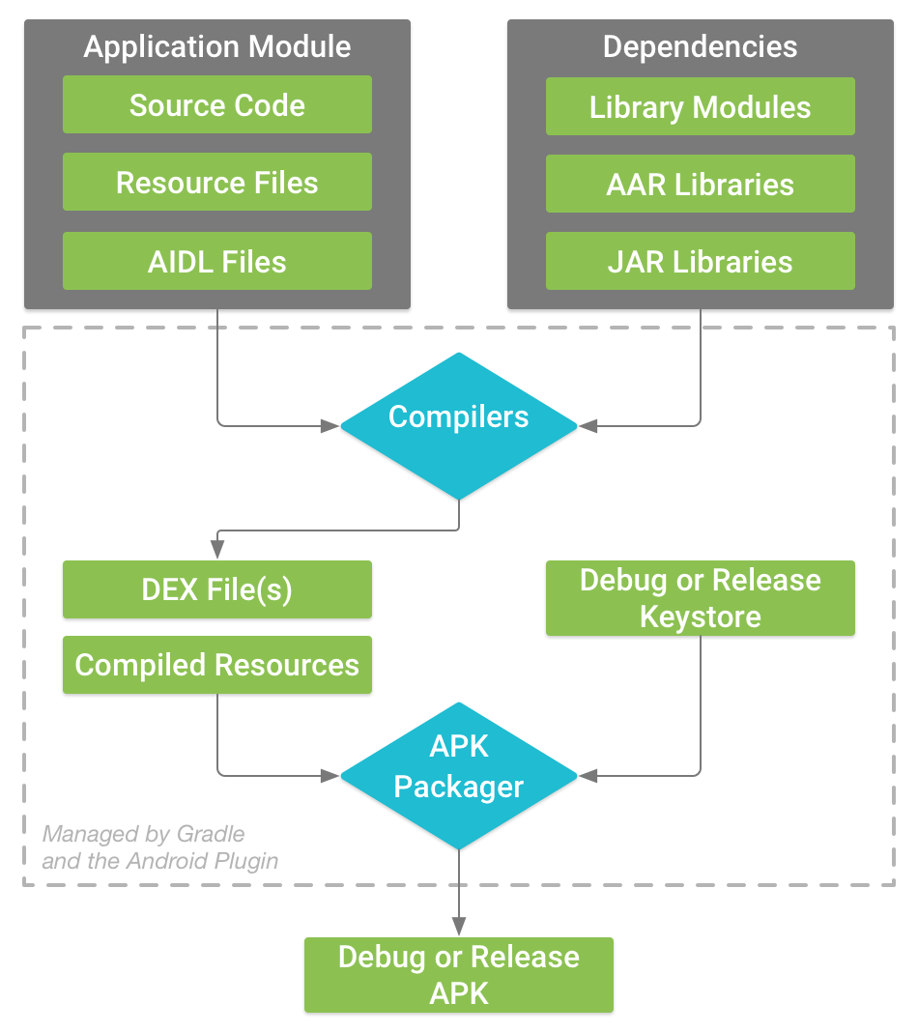
What does it take to build the project?
Actually, quite a lot.
developer.android.com/sdk/installing/studio-build.html

Slide 65

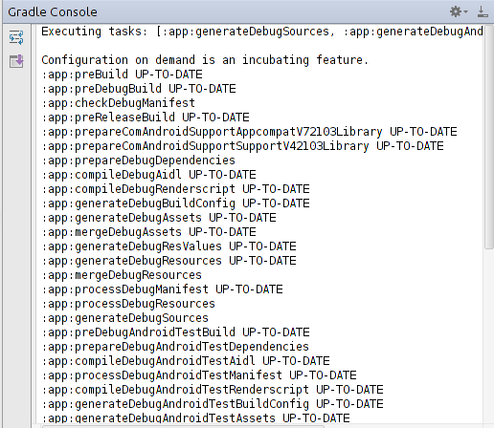

What does it take to build the project?
But Gradle helps us with it.
/developer.android.com/sdk/installing/studio-build.html

Slide 66
I click “Run”, You say Ho!
Android studio Builds the project,
Loads it to a device (real or virtual)
Executes it on the device, attach a debugger if needed.
adb install YourApp.apk
adb shell am start -n com.examp.name...
developer.android.com/tools/help/adb.html

Slide 67

Any Questions?

Slide 68
Agenda
Android Studio & First Project
Activity & Layouts
Resources
Java & xml works together
Different configurations
Intents
Activity Lifecycle
Toasts, Logs, etc.

Slide 69
A Little Bit On Layouts

Slide 70
Views
Everything in that XML file is a View.
A View:
Knows to draw itself
Used for user interaction
Has (at least) height and width (match_parent / wrap_content/fixed)

Slide 71
ViewGroup (Layout)
A special kind of view.
Knows to position other views on the screen.

Slide 72
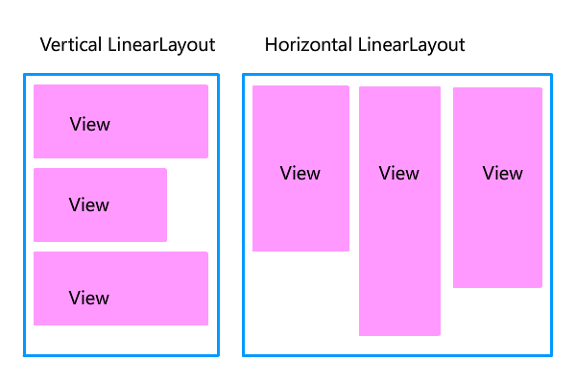
LinearLayout
Lays items in a row or a column.
Can also divide existing space by weight.
developer.android.com/guide/topics/ui/layout/linear.html

Slide 73
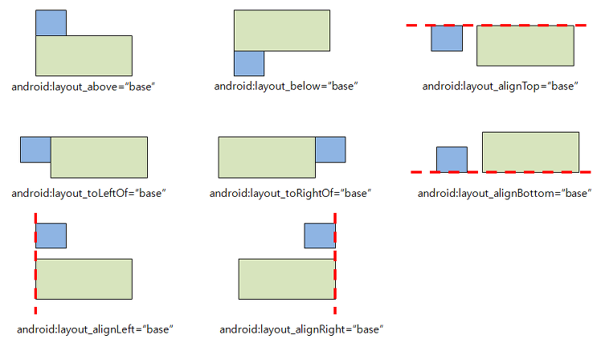
RelativeLayout
Lays items next to each other, or relative to their parent.
developer.android.com/guide/topics/ui/layout/relative.html

Slide 74
ConstraintLayout
…we’ll discuss later on the course…
developer.android.com/training/constraint-layout/index.html

Slide 75
ConstraintLayout
…we’ll discuss later on the course…
Or no ¯\_(ツ)_/¯
developer.android.com/training/constraint-layout/index.html

Slide 76
How does the layout look?

Slide 77
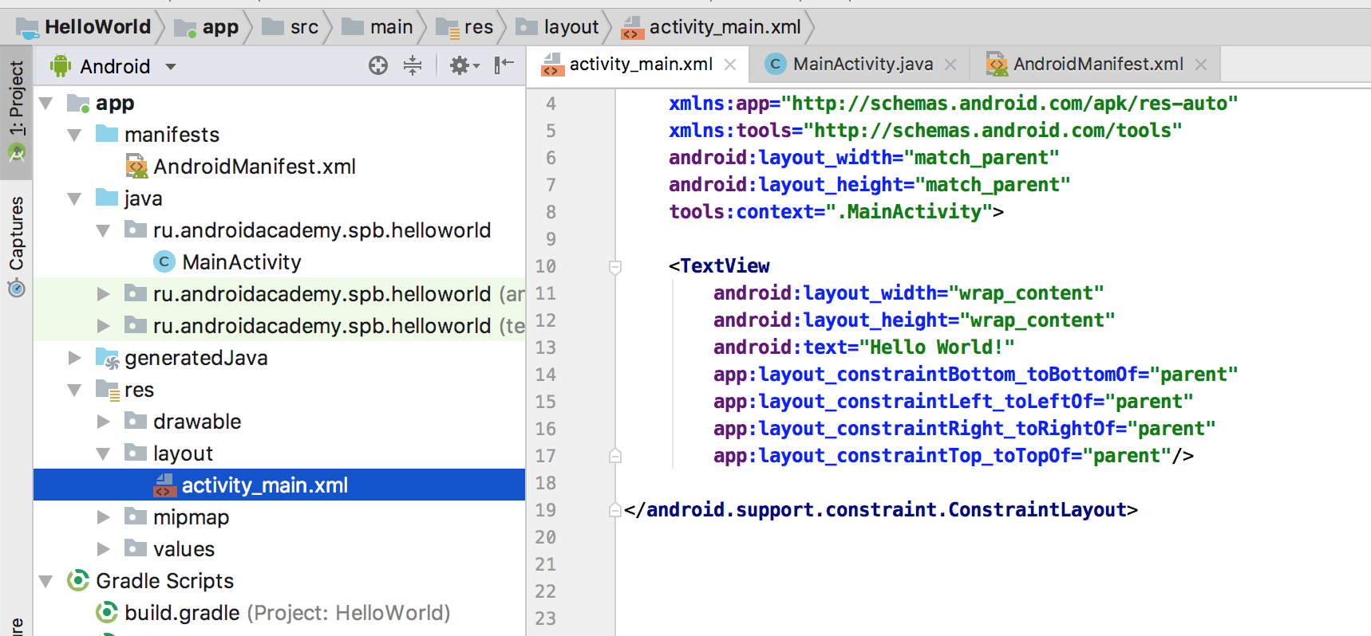

Slide 78
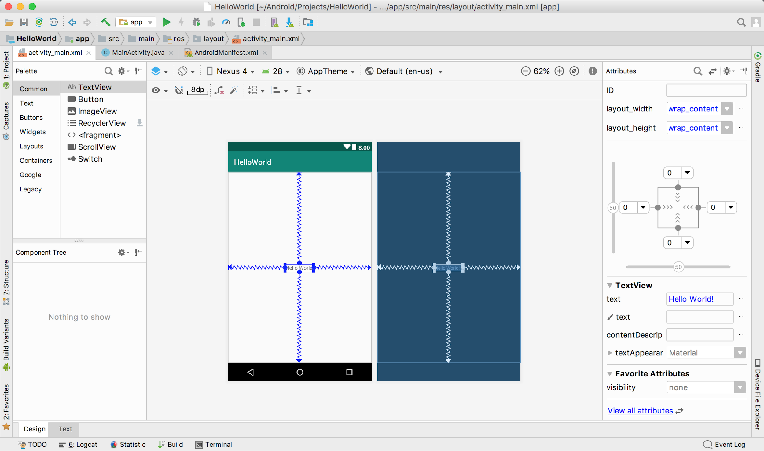
3
1
2

Slide 79
Hello World

Slide 80
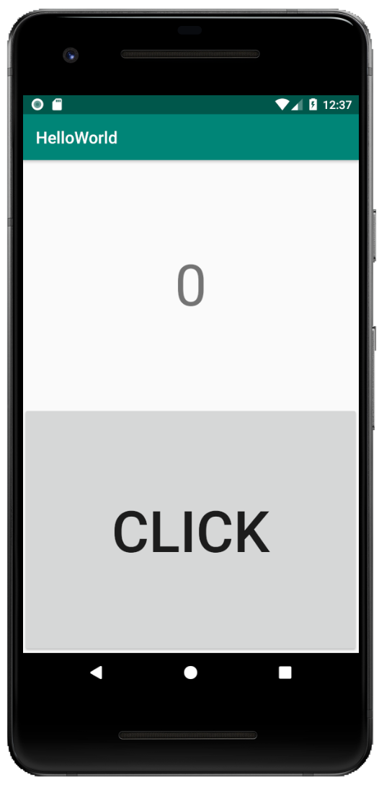

Slide 81
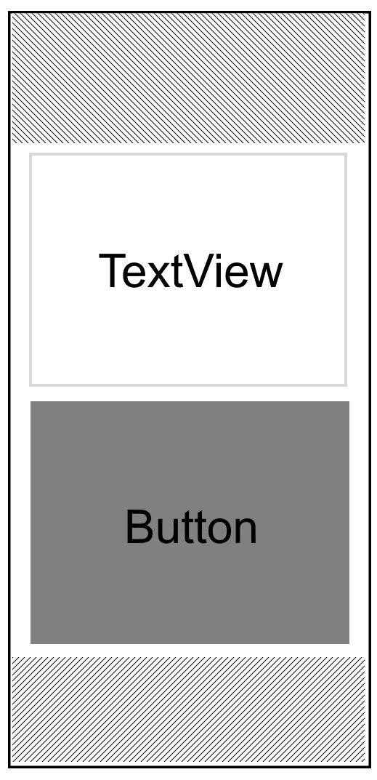

Slide 82
activity_main.xml
<?xml version="1.0" encoding="utf-8"?> <LinearLayout xmlns:android="http://schemas.android.com/apk/res/android" xmlns:app="http://schemas.android.com/apk/res-auto" android:layout_width="match_parent" android:layout_height="match_parent" android:orientation="vertical"> <TextView android:layout_width="match_parent" android:layout_height="0dp" android:layout_weight="1"/> <Button android:layout_width="match_parent" android:layout_height="0dp" android:layout_weight="1"/> </LinearLayout>

Slide 83
LinearLayout orientation
<?xml version="1.0" encoding="utf-8"?> <LinearLayout xmlns:android="http://schemas.android.com/apk/res/android" xmlns:app="http://schemas.android.com/apk/res-auto" android:layout_width="match_parent" android:layout_height="match_parent" android:orientation="vertical"> <TextView android:layout_width="match_parent" android:layout_height="0dp" android:layout_weight="1"/> <Button android:layout_width="match_parent" android:layout_height="0dp" android:layout_weight="1"/> </LinearLayout>

Slide 84
activity_main.xml
<?xml version="1.0" encoding="utf-8"?> <LinearLayout xmlns:android="http://schemas.android.com/apk/res/android" xmlns:app="http://schemas.android.com/apk/res-auto" android:layout_width="match_parent" android:layout_height="match_parent" android:orientation="vertical"> <TextView android:layout_width="match_parent" android:layout_height="0dp" android:layout_weight="1"/> <Button android:layout_width="match_parent" android:layout_height="0dp" android:layout_weight="1"/> </LinearLayout>

Slide 85
**making things prettier**

Slide 86
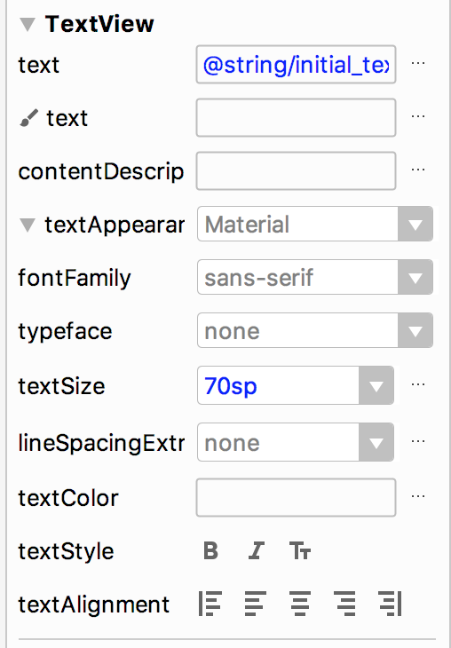
Change Text Size (editor)

Slide 87
What is SP?
We’ll see in a bit

Slide 88
Change Text Size (code)
<TextView
...
android:textSize="70sp"/>

Slide 89
Save Size
We have set up the value 70sp twice!
Repetition in code?? Not for me!

Slide 90
Save Size in dimens.xml
<resources>
<dimen name="large_text_size">70sp</dimen>
</resources>

Slide 91
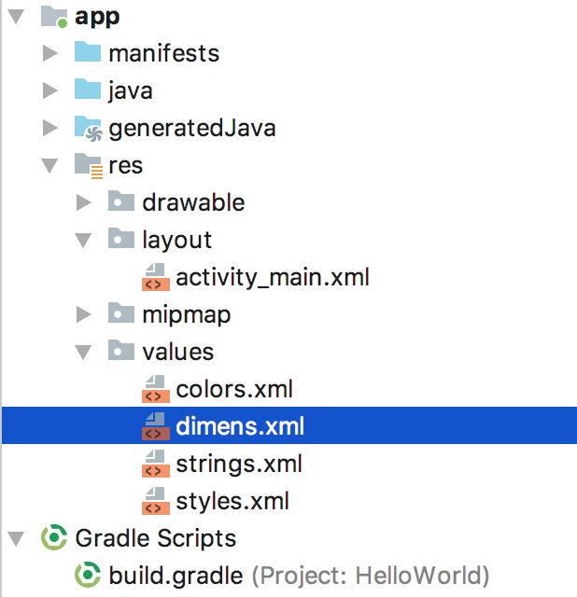
dimens.xml

Slide 92
Use Size From dimens.xml
<TextView
...
android:textSize="@dimen/large_text_size"/>

Slide 93
Saving String Resources
<Button
...
android:text="CLICK"/>

Slide 94
Saving String Resources
<Button
...
android:text="@string/click_button_text"/>

Slide 95
Saving String on strings.xml
<resources>
<string name="app_name">HelloWorld</string>
<string name="initial_text">0</string>
<string name="click_button_text">CLICK</string>
</resources>

Slide 96
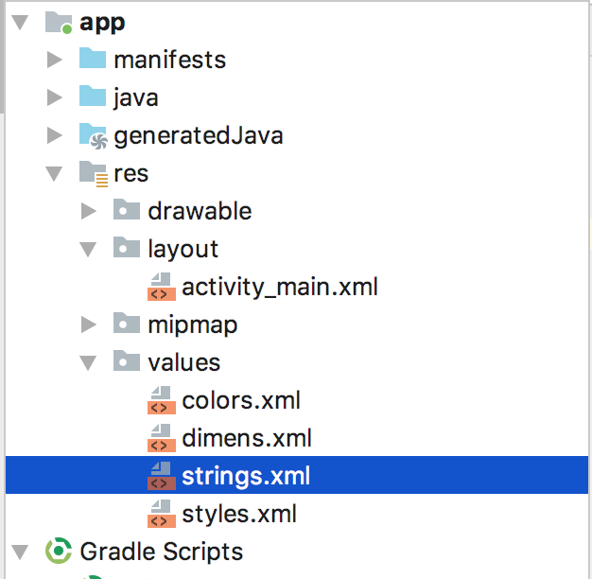
strings.xml

Slide 97
Resources
Drawable (images)
Animations
Colors
Themes (styles)
Raw
Booleans / Integers / ...

Slide 98
Agenda
Android Studio & First Project
Activity & Layouts
Resources
Java & xml works together
Different configurations
Intents
Activity Lifecycle
Toasts, Logs, etc.

Slide 99
Java & xml

Slide 101
Let’s make clicker!
Access Views in xml from Java code
Change text in TextView
Set onClickListener to Button
Increment counter & update text

Slide 102
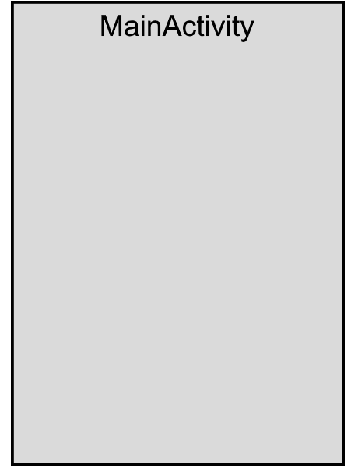
Activity
public class MainActivity extends AppCompatActivity {
@Override
protected void onCreate(Bundle savedInstanceState) {
super.onCreate(savedInstanceState);
}
}

Slide 103
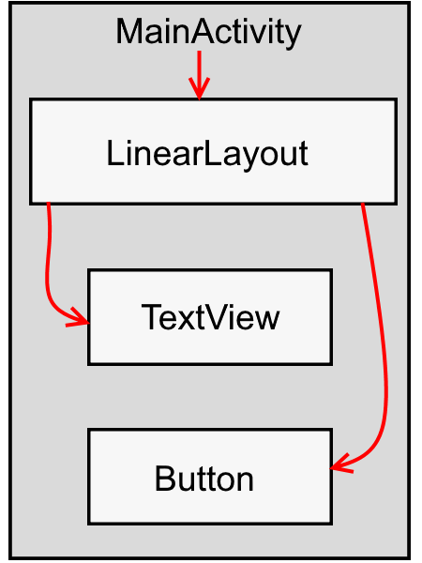
setContentView
public class MainActivity extends AppCompatActivity {
@Override
protected void onCreate(Bundle savedInstanceState) {
super.onCreate(savedInstanceState);
setContentView(R.layout.activity_main);
}
}

Slide 104
Reference to the view on code
public class MainActivity extends AppCompatActivity {
private TextView counterText;
@Override
protected void onCreate(Bundle savedInstanceState) {
super.onCreate(savedInstanceState);
setContentView(R.layout.activity_main);
counterText = findViewById(/*...*/);
}
}

Slide 105
Assign view ID
<TextView
...
android:id="@+id/counter_text"/>

Slide 106
Reference to the view on code
public class MainActivity extends AppCompatActivity {
private TextView counterText;
@Override
protected void onCreate(Bundle savedInstanceState) {
super.onCreate(savedInstanceState);
setContentView(R.layout.activity_main);
counterText = findViewById(R.id.counter_text);
}
}

Slide 107
Change text in TextView
counterText = findViewById(R.id.counter_text);
counterText.setText("Hello World!");

Slide 108
Change text in TextView
counterText = findViewById(R.id.counter_text);
counterText.setText(R.string.initial_text);

Slide 109
Find a button and set OnClickListener
Button counterButton = findViewById(R.id.counter_button);
counterButton.setOnClickListener(new View.OnClickListener() {
@Override
public void onClick(View v) {
// TODO : update counter
}
});

Slide 110
Let’s make counter!
We’ll need a counter variable. Let’s make an int, and init it to 0.
public class MainActivity extends AppCompatActivity {
private int counter = 0;
//...
}

Slide 111
Setting onClickListener
counterButton.setOnClickListener(new View.OnClickListener() {
@Override
public void onClick(View v) {
counter++;
String text = String.valueOf(counter);
counterText.setText(text);
}
});

Slide 112
Not xml?
<Button
android:id="@+id/counter_button"
android:layout_width="match_parent"
android:layout_height="0dp"
android:layout_weight="1"
android:onClick="onButtonClick"/>
public void onButtonClick(View view) {
}

Slide 113
A little bit more fun
public void onClick(View v) {
counter++;
String text;
if (counter % 10 == 0) {
text = getString(R.string.app_name);
} else {
text = String.valueOf(counter);
}
counterText.setText(text);
}

Slide 114

Questions?

Slide 115
Quick UML Recap
Has, Inflates
setContentView
Activity
View
extends
Has Many
ViewGroup
Not a ViewGroup
LinearLayout
TextView
RelativeLayout
Button
ListView
AdapterView
ImageView

Slide 116
Agenda
Android Studio & First Project
Activity & Layouts
Resources
Java & xml works together
Different configurations
Intents
Activity Lifecycle
Toasts, Logs, etc.

Slide 117
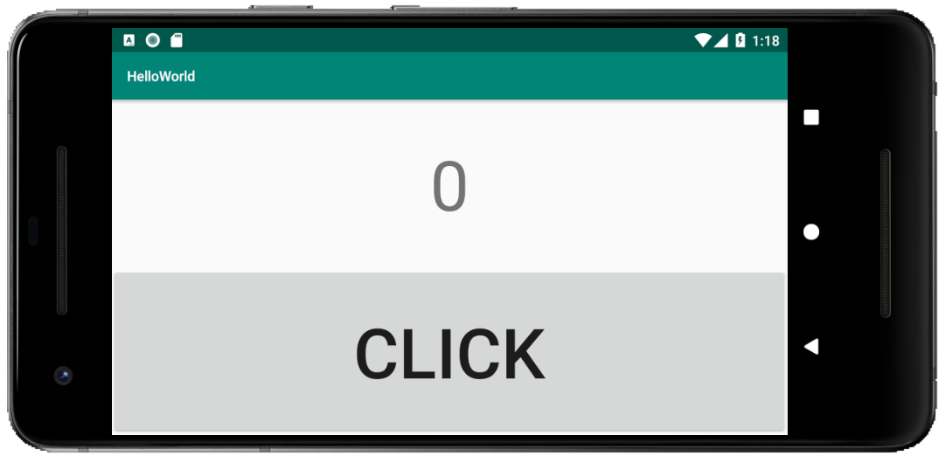
Rotate the device

Slide 118


Slide 119
There a bug with our mine…
I know…
but we’ll get to it later...

Slide 120
Rotate the device

Slide 121
Create a different layout for landscape

Slide 122
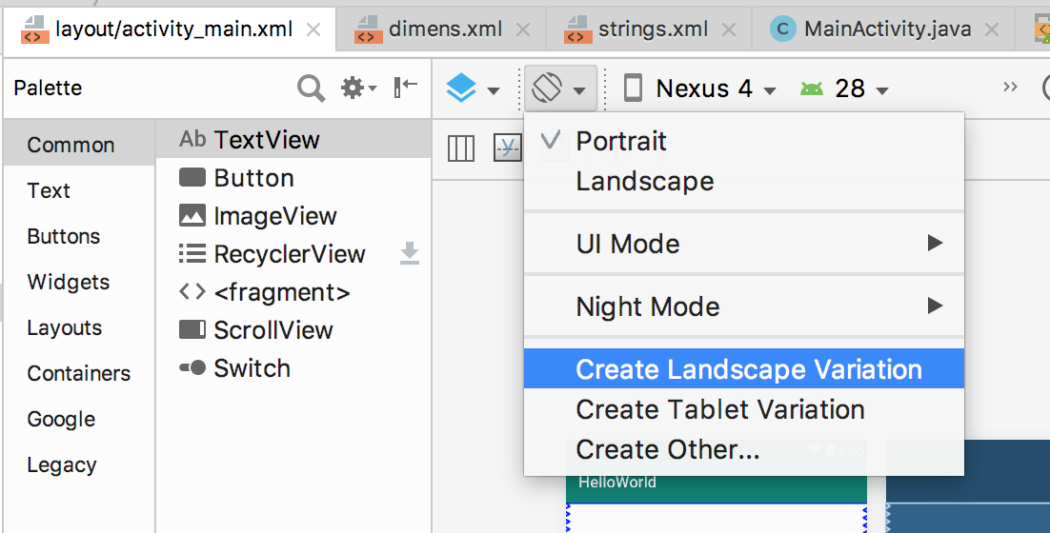

Slide 123

Activity_main.xml (#2)
<?xml version="1.0" encoding="utf-8"?> <LinearLayout xmlns:android="http://schemas.android.com/apk/res/android" xmlns:app="http://schemas.android.com/apk/res-auto" android:layout_width="match_parent" android:layout_height="match_parent" android:orientation="horizontal"> <TextView android:layout_width="0dp" android:layout_height="match_parent" android:layout_weight="1"/>
<Button android:layout_width="0dp" android:layout_height="match_parent" android:layout_weight="1"/> </LinearLayout>

Slide 124

Now: rotate the device

Slide 126

First android device
HTC Dream
320x480px (2:3)
180 ppi
3.2” (81mm)
en.wikipedia.org/wiki/HTC_Dream

Slide 127

Current Android Device
Pixel 2
1080x1920 (16:9)
441 ppi
5.0 (127mm)
en.wikipedia.org/wiki/Pixel_2

Slide 128

Big Android Device
Nexus 10 (Tablet)
2560x1600px
300ppi
10.1”
en.wikipedia.org/wiki/Nexus_10

Slide 129

Small Android Device
LG G Watch
Most
Same techniques apply
en.wikipedia.org/wiki/Android_Wear

Slide 130

The difference is Big

Slide 131
Differences
Pixel Density
Screen size
Orientation
Device Class
OS Version
Language
Accessibility

Slide 133
Agenda
Android Studio & First Project
Activity & Layouts
Resources
Java & xml works together
Different configurations
Intents
Activity Lifecycle
Toasts, Logs, etc.

Slide 134
We need more Activities!

Slide 135
Creating another Activity
Using Android Studio, use Alt + Insert -or- Command + N to create something new. This shortcut is also context aware.
Let’s create a new activity, and call it SecondActivity.
developer.android.com/training/basics/firstapp/starting-activity.html

Slide 136

File >> New Project

Slide 137

File >> New Project

Slide 138

How to open SecondActivity
You can’t open an activity on your own - Android opens an activity for you.
This is done by using an Intent.

Slide 139



Intents have...
Component Name
Action
Data (and Type)
Category
Extras
Flags
used for Explicit Intents
used for Implicit Intents
used to tell things to the recipient
used to tell things to the messenger

Slide 140
So now, the code for the button is
private void openActivity() {
Intent secondActivityIntent = new Intent(this, SecondActivity.class);
startActivity(secondActivityIntent);
}

Slide 141
Any Questions?

Slide 142
More buttons!
Create a new button
which will open the new activity

Slide 143
Pass arguments to next activity
private static final String KEY_COUNT = "KEY_COUNT";
private void openSecondActivity() {
Intent secondActivityIntent = new Intent(this, SecondActivity.class);
secondActivityIntent.putExtra(KEY_COUNT, counter);
startActivity(secondActivityIntent);
}

Slide 144

Toasts
Simple feedback about an operation in a transient small popup.
The activity remains interactive -
whereas the toast itself isn’t.
developer.android.com/guide/topics/ui/notifiers/toasts.html

Slide 145

Make a Toast
Toast.makeText(this,"Hello Indeed!",Toast.LENGTH_LONG)
.show();

Slide 146
Most common bug with Toasts:
DON’T FORGET TO CALL show() !

Slide 147
Did the data pass to SecondActivity?
See that the data passed
@Override
protected void onCreate(@Nullable Bundle savedInstanceState) {
super.onCreate(savedInstanceState);
int count = getIntent().getIntExtra(KEY_COUNT, 0);
String text = String.valueOf(count);
Toast.makeText(this, text, Toast.LENGTH_LONG).show();
}

Slide 148
Best Practice: Start Activity Statically
MainActivity:
public void openSecondActivity(View view) {
SecondActivity.start(this, counter);
}

Slide 149
Best Practice: Start Activity Statically
SecondActivity:
public static void start(Activity activity, int counter) {
Intent secondActivityIntent = new Intent(activity, SecondActivity.class);
secondActivityIntent.putExtra(KEY_COUNTER, counter);
activity.startActivity(secondActivityIntent);
}

Slide 150
Any Questions?

Slide 151
Agenda
Android Studio & First Project
Activity & Layouts
Resources
Java & xml works together
Different configurations
Intents
Activity Lifecycle
Toasts, Logs, etc.

Slide 152

Next Topic:
Activity Lifecycle

Slide 153

The Activity Lifecycle

Slide 154
The Activity Lifecycle
When activity lifecycle state changes,
Android lets us know with callback.

Slide 155
Logging

Slide 156
Logging
Definition: A logfile is a file that records either events that occur in an operating system or other software runs.

Slide 157

Any Questions?
HERE

Slide 158


Logging

Slide 159
Log level
verbose (.v)
Debug (.d)
Info (.i)
Warn (.w)
Error (.e)

Slide 160
Log lifecycle
private static final String TAG = "Hello World";
@Override
protected void onResume() {
super.onResume();
Log.i(TAG, "onResume");
}
@Override
protected void onPause() {
super.onPause();
Log.i(TAG, "onPause");
}

Slide 161
Any Questions?

Slide 162
Agenda
Android Studio & First Project
Activity & Layouts
Resources
Java & xml works together
Different configurations
Intents
Activity Lifecycle
Toasts, Logs, etc.

Slide 163
Recap
What’s an Activity? Describe Activity Lifecycle methods.
What’s the Manifest?
Which resource types do we have?
What are View, ViewGroup and LinearLayout?
Which class helps us to open another Activity? How to pass data between Activities?
Which types of Intents do we have? What’s the difference?
What’s a Toast? How to show it?
How to print information to Android log file?

Slide 164

And now….Exercise!

Slide 165
Install Android Studio & run project
Instructions can be found here
bit.ly/2FECy7p

Slide 166

devfest-spb.com/

Slide 167


Slide 168
We’re Here For Questions!!!

